Slide 1
Practical X
COMPUTER SCIENCE 2B NETWORK PROJECT
by , University of Johannesburg

Slide 2
Problem Statement
About 20 to 22 million people in South Africa use a smartphone, which accounts for about one third of the population.
This means that about the same number of people or more have access to a camera
There is a need for an image editing tool.

Slide 3
Solution
An interactive image editing tool
mouse events trigger parts of an image being manipulated
Using the provided API to manipulate and save images

Slide 4
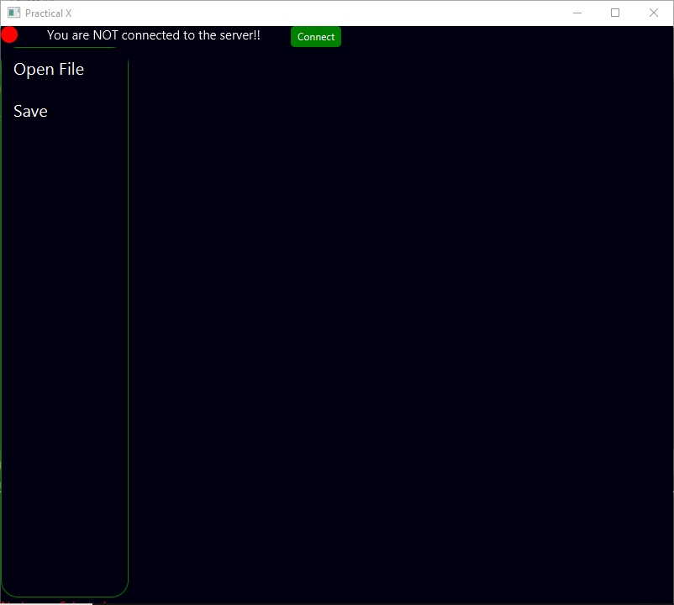
Methodology

Slide 5
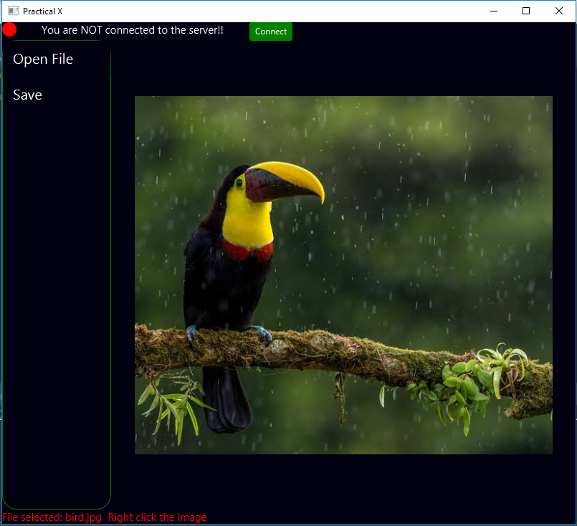
Methodology

Slide 6
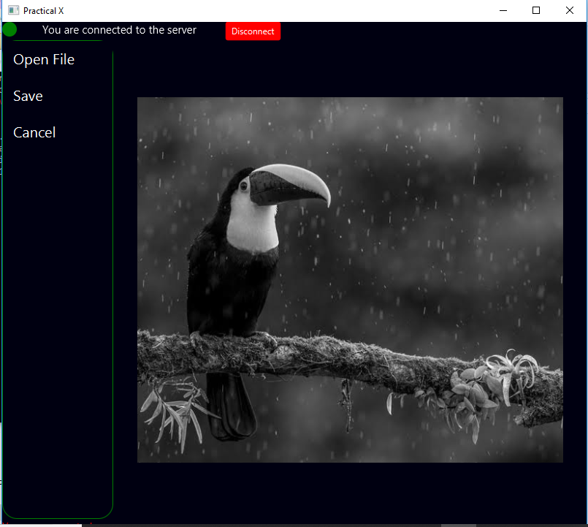
Methodology

